Slide 1
6th grade Language Arts class
Presented by,
Jill Goodman

Slide 2
The Scope of the Curriculum:
To think, question, read, write, discuss, create, and discover.
To develop an understanding and an appreciation of literature.
To explore a variety of reading materials.
To align with the Ohio Common Core
State Standards

Slide 3
Program Materials:
Google Classroom
class novels
vocabulary - roots & stems
quotation rotation w/ response log
journal
grammar connected to literature
Chromebooks w/ online sources
L.A. Weebly
Accelerated Reader
online newspapers…

Slide 4
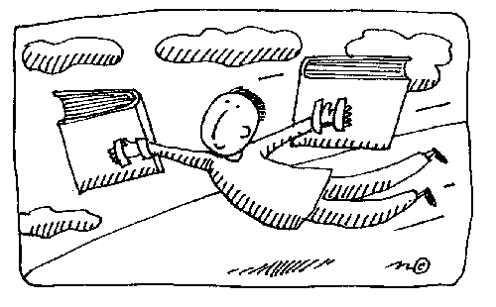
Reading Assignments:
usually begin at school
requires regular annotation
audio versions available
ties into grammar & vocabulary

Slide 5
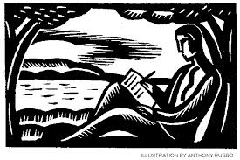
Writing Assignments:
Variety of paragraphs / extended responses
Informative essays -
Acceptance and survival units
Argumentative essay -
Research based – argument unit
Fictional narrative -
Cinderella unit

Slide 6
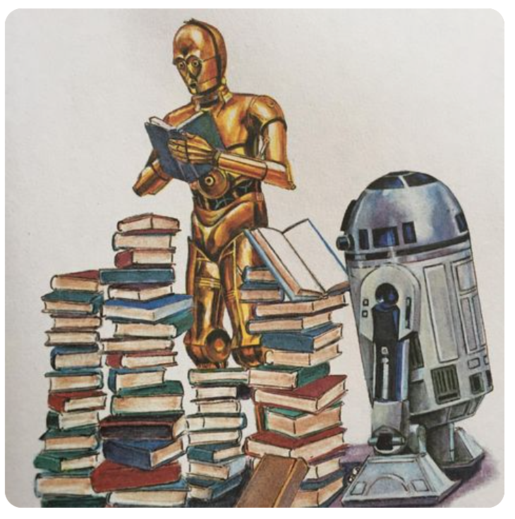
Reading Analysis Essays
(RAE):
Assigned regularly.
Prompts based on key standards.
Broken into pre-writing phase
> writing phase
Steps modeled in class and made available.
Shared via Google drive and website.
Rubric used to self check.

Slide 7
Homework / Grading:
Assignments 2 – 3 times a week.
Grading expectations shared with students
6th grade weebly
http://6thgradebms.weebly.com/
Homework posted here
Link to Infinite Campus

Slide 8
6th grade Extracurricular Activities:
Study Club
‘Beachwords’ - the BMS newspaper
Yearbook
Student Council
Ecology Club
Power of the Pen
Chess Club
Science Olympiad…

Slide 9
Contact info:
phone:
831-0355 ex. 205
email:
jag@beachwoodschools.org
L.A. Weebly site:
http://languageartswithmrsgoodman.weebly.com

