Slide 1
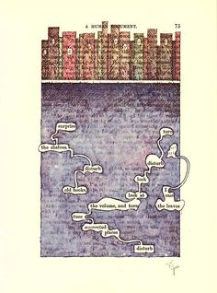
Blackout Poetry
Tom Phillips
Middle School Masters

Slide 2
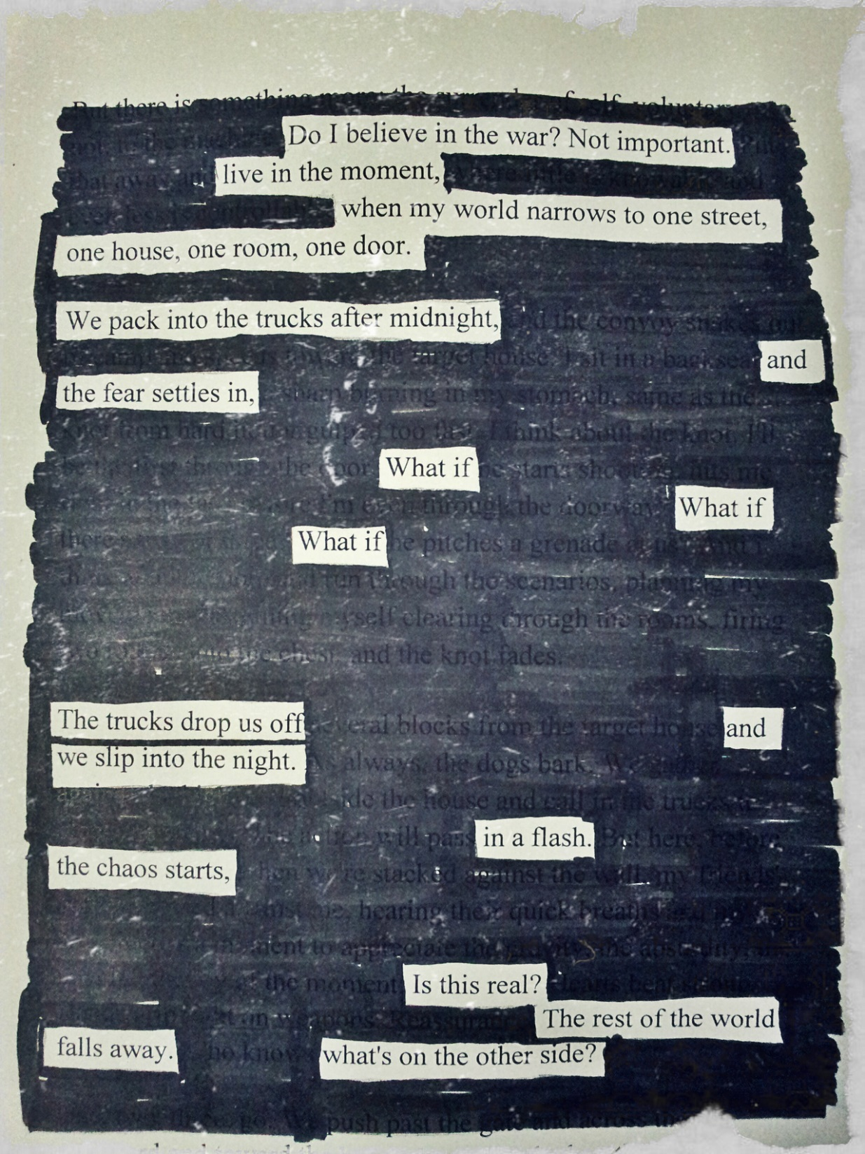
Blackout Poetry
Note to Teachers
At the beginning of the year, have your media specialist save books that would ordinarily be thrown away or destroyed. Before you know it, you have enough “text” for all of your students and even for some of your colleagues!

Slide 3
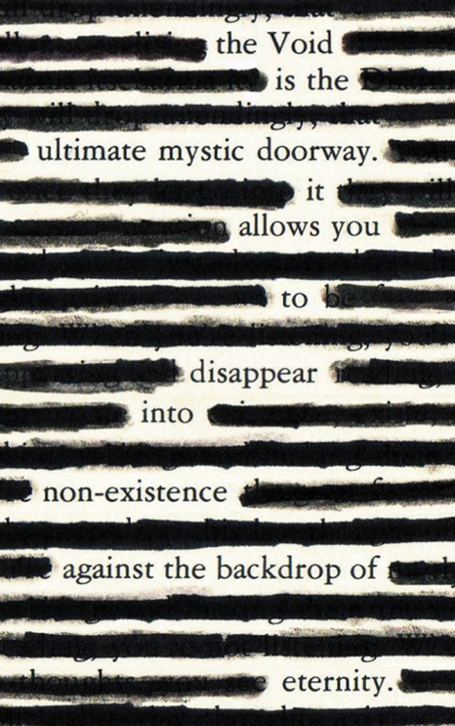
What is “Blackout Poetry?”
Furtive Labors
"Blackout poetry" is poetry made by redacting [blacking out] the words on a page from a book, newspaper, magazine, or website with a permanent marker, leaving behind only a few choice words to make a poem.
Alec Essefic

Slide 4
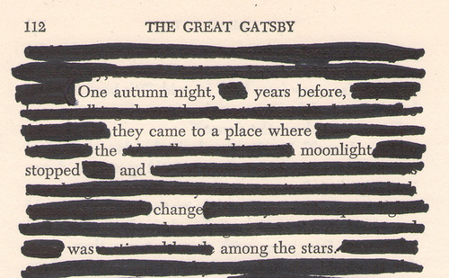
Example
poetry potion.com

Slide 5
So, how do I “write” this poem?
The most important thing you can do is read your chosen text, read it again, and read it again!
After you have read the text several times, something creative will begin to happen.
Certain words on the page will start to form a thought, theme, or story in your mind.
Once your thought or theme begins to gel, it’s time to create your poem.

Slide 6
It’s time to begin…
Using ONLY a PENCIL, closely re-read and LIGHTLY CIRCLE or UNDERLINE the words you want TO KEEP.
Read over your “poem” AGAIN carefully to make sure it makes sense and has the right tone.
When you are completely satisfied with your work, take a black marker and begin redacting [blacking out] all of the words EXCEPT FOR THE CIRCLED WORDS.
Now, read over your poem for clarity and share it with another student!
Remember: Poetry is meant to be shared aloud!

Slide 7
Now, if you are really creative, your poem might look like this!!
"Mud on the Tires, Ink on My Hands." : Blackout Poetry.

Slide 8
Blackout Poetry Rubric
Suggested rubric for either self-evaluation or peer review.
Blackout Poem | Possible Points | If less than 5, provide suggestion for improvement. If 5, exactly what makes this poem a 5?
Is Clear & Understandable | 5 4 3 2 1
Tells a Story | 5 4 3 2 1
Exhibits effort [pleasing to the eye] | 5 4 3 2 1

Slide 9
Blackout Poetry Reflection
A brief summary of your blackout poem. What are you trying to express
Who is the speaker of your poem?
What is the tone of your poem? [Tone is the author’s attitude toward the subject.]
What words and phrases help to express the tone of your poem? [word choice]
What was your favorite part about the blackout poetry project? Explain.
If you could do this project again, what would you do differently? Why?
How do you feel about the overall piece and how it came together?
If you had to include one image to represent your poem, what would it be? Explain your choice based on details from your poem.

