Slide 1
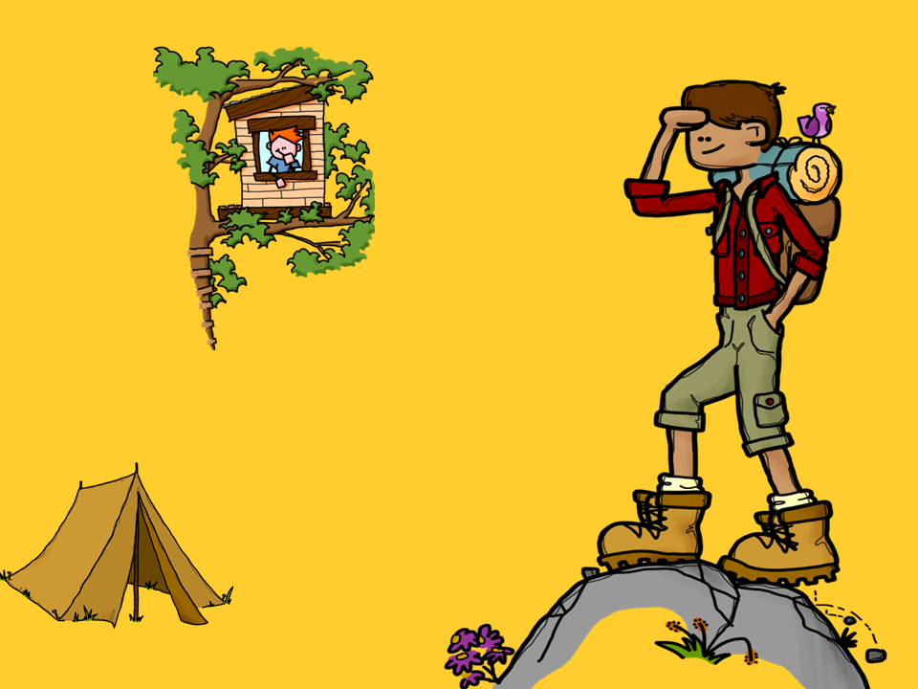
Compare and Contrast
Text Structure Practice

Slide 2
Compare and Contrast
Compare and contrast is a text structure.
Text structures are ways that authors organize a piece of writing. Compare and contrast is one of these ways.

Slide 3
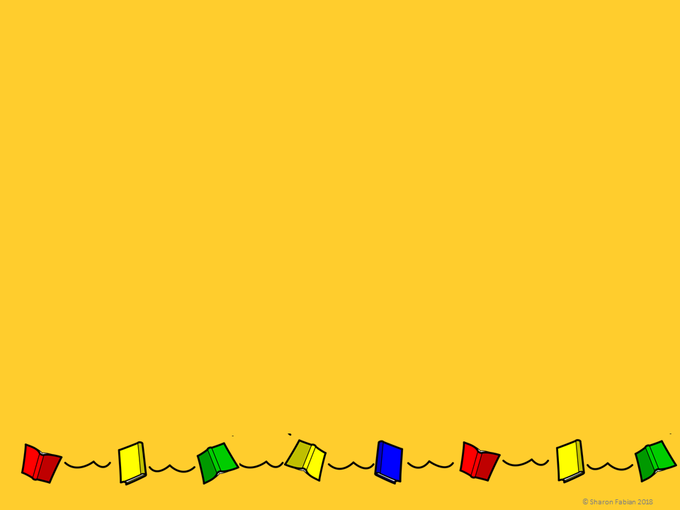
Compare and Contrast
Compare means to tell how two things are the same.
Contrast means to tell how two things are different.
The expression compare and contrast means to tell both the similarities and the differences.

Slide 4
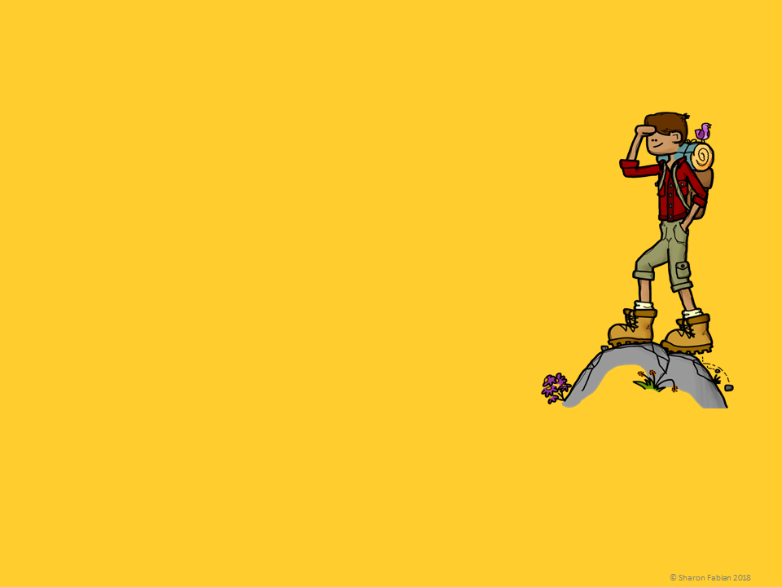
Similarities and Differences
To Compare and contrast, look at features that both things have in common - similarities.
Then look for features that only one or the other has - differences.
Think about an article comparing two movies. Maybe they both have great special effects. That would be a similarity. Supposes that one movie has famous stars and the other has unknown actors. That’s a difference.

Slide 5
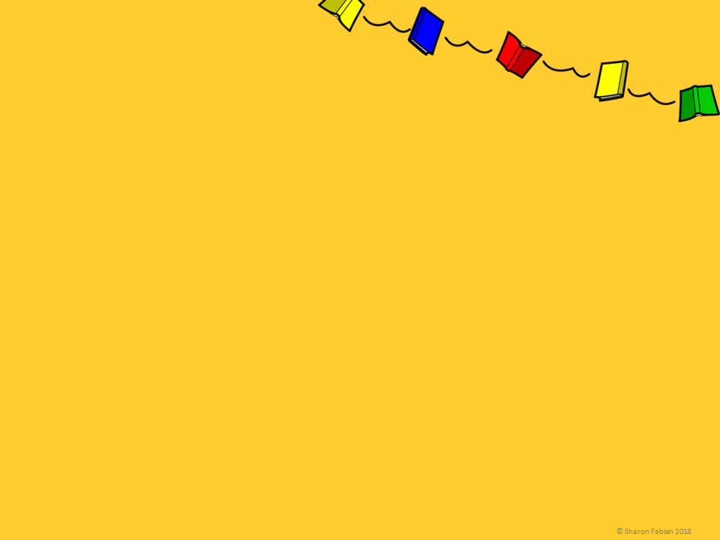
Key Words
There are lots of key words that can signal a compare and contrast relationship. Here are some of them:
Compare
same, similar, similarly, both, like, alike, likewise, in common, also, as well as, in the same way, too
Contrast
different, difference, however, but, although, on the other hand, even though, contrary to, unlike, instead

Slide 6
Graphic Organizers
Venn diagrams are often used to organize this type of information.
Thing 1
Thing 2
Differences
Differences
Similarities
© Sharon Fabian 2018

Slide 7
Graphic Organizers
Here’s a fancy Venn diagrams for comparing three things at once!
Thing 1
Thing 2
Differences
Differences
Similarities
The center part is for similarities among all three things. The other three small sections around the center are for similarities between two things.
Differences
Thing 3
© Sharon Fabian 2018

Slide 8
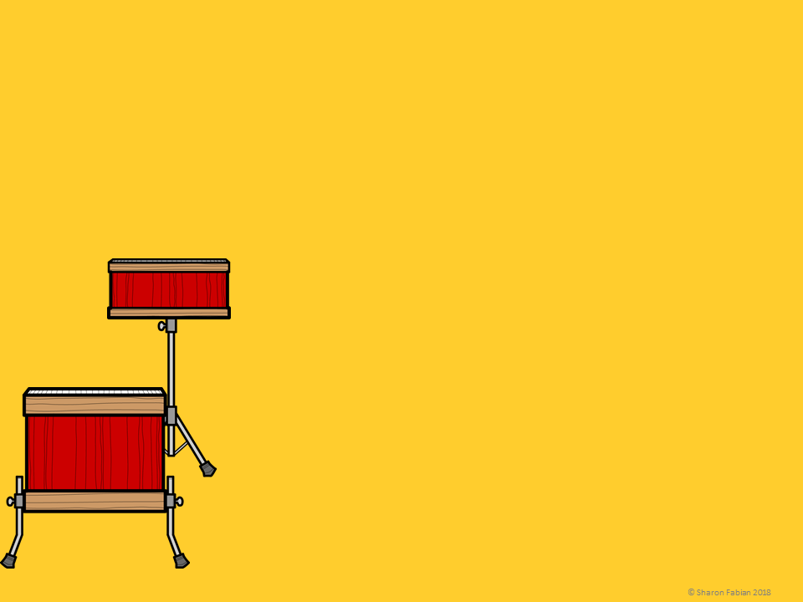
Graphic Organizers
A chart with two or more columns can also work.
THING 1 ONLY | THING 2 ONLY | BOTH

Slide 9
Can you find the two things that are being compared in each of the following sentences?

Slide 10
What two things are being compared in each sentence? Are they similar or different?
Marlin are salt water fish, however
brook trout live in fresh water.
2. My angel fish has long thin fins and is white with black stripes, but my betta fish has a long flowing tail and is bright pink and blue.
3. I caught two small sunfish, and Tara caught two small sunnies too.

Slide 11
What two things are being compared in each sentence? Are they similar or different?
Marlin are salt water fish, however brook trout live in fresh water.
2. My angel fish has long thin fins and is white with black stripes, but my betta fish has a long flowing tail and is bright pink and blue.
3. I caught two small sunfish, and Tara caught two small sunfish too.
marlin, brook trout - different
angel fish, betta fish - different
my fish, Tara’s fish - similar

Slide 12
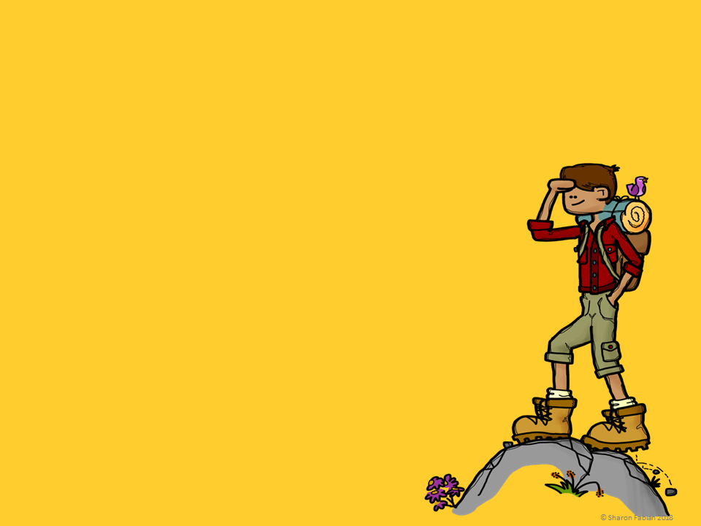
What two things are being compared in each sentence? Are they similar or different?
These new hiking boots are lasting much longer than my first pair.
Since we both arrived in old battered vans, Todd and I had something in common right from the start.
Hiking Grandfather Mountain was a piece of cake in contrast with hiking Stone Mountain!

Slide 13
What two things are being compared in each sentence? Are they similar or different?
These new hiking boots are lasting much longer than my first pair.
Since we both arrived in old battered vans, Todd and I had something in common right from the start.
Hiking Grandfather Mountain was a piece of cake in contrast with hiking Stone Mountain!
new boots, old boots - different
my vehicle, Todd’s vehicle - similar
Grandfather Mountain, Stone Mountain - different

Slide 14
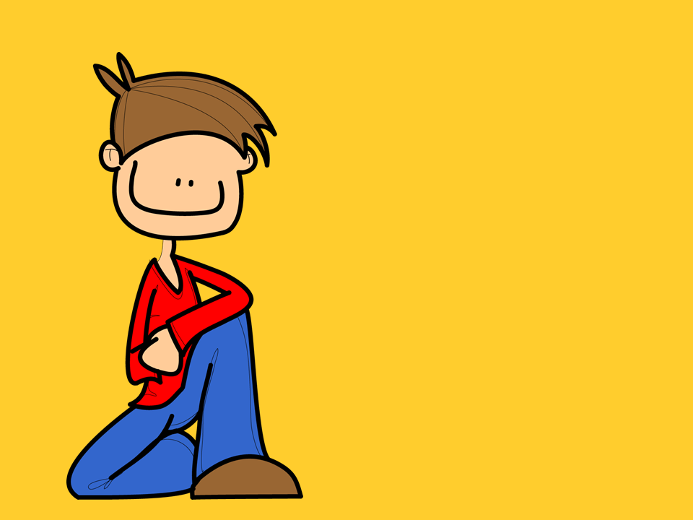
Can you find the differences between the two things that are being compared in each of the following passages?

Slide 15
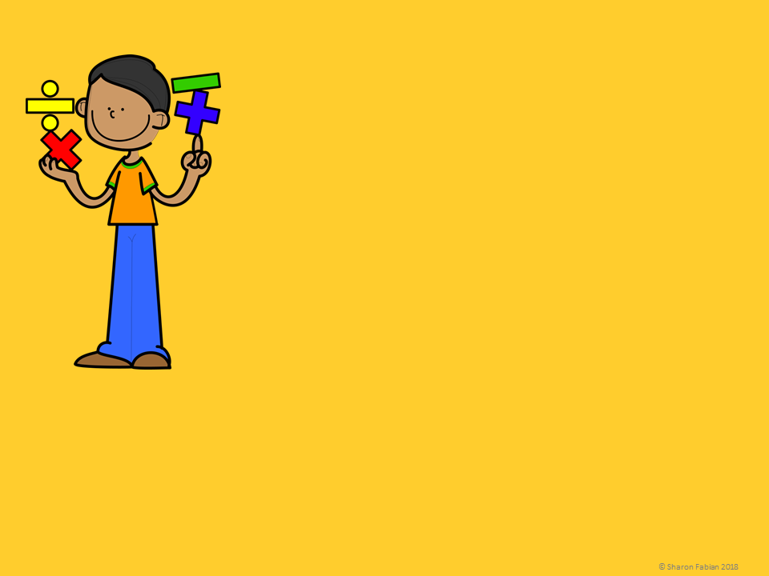
In my opinion, math is easier than English. For one thing, math requires skills with numbers while English requires verbal skills, and I am better at numbers! In addition, English is for creative thinkers, however Math is for logical thinkers. Also math is just more fun than English! (In my opinion.)
What two things being compared?
What differences between the two did the writer mention?

Slide 16
In my opinion, math is easier than English. For one thing, math requires skills with numbers while English requires verbal skills, and I am better at numbers! In addition, English is for creative thinkers, however Math is for logical thinkers. Also math is just more fun than English! (In my opinion.)
Math and English are being compared.
Math requires numerical skills; English requires verbal skills.
Math is more logical; English is more creative.
Math is more fun than English.

Slide 17
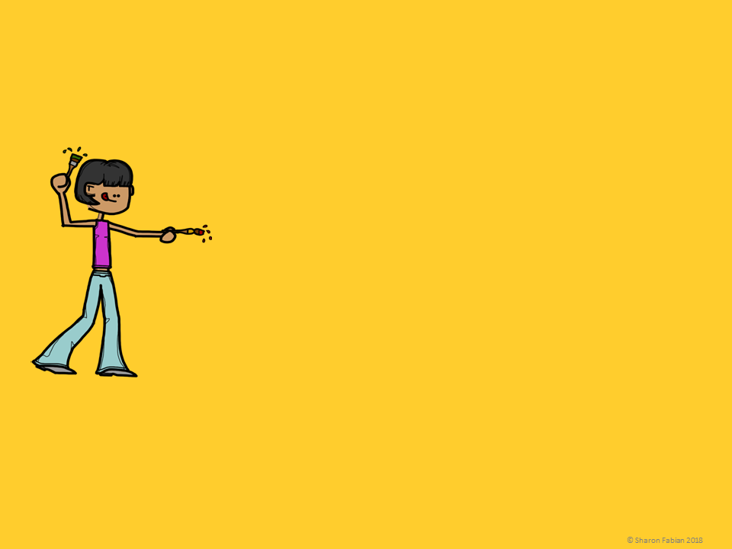
Most of my schedule is already decided, but I did get to choose one elective. I had a hard time deciding between art and band. In art, I would get to paint and be creative, but in band I would get to be with my friends. Either one would be helpful in a way, because I want to be a graphic designer some day, but I also want to try out for marching band in high school.
What two things being compared?
What differences between the two did the writer mention?

Slide 18
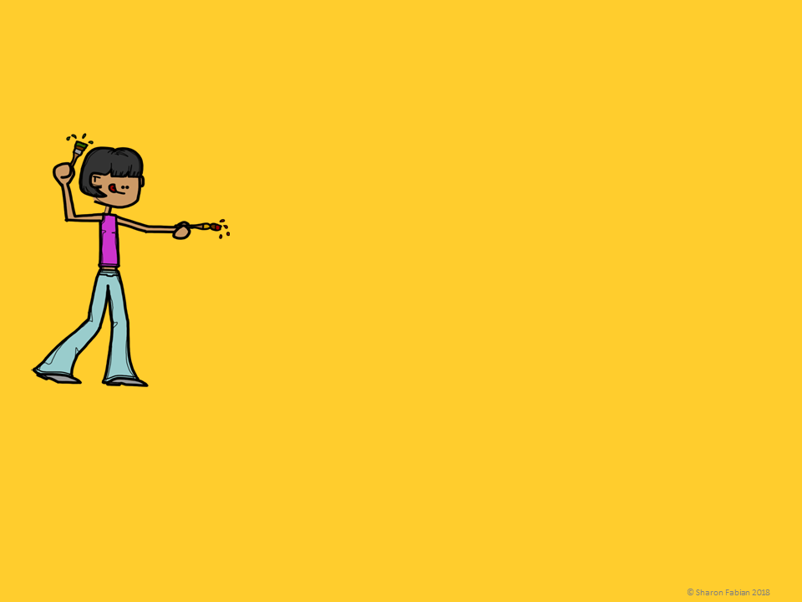
Most of my schedule is already decided, but I did get to choose one elective. I had a hard time deciding between art and band. In art, I would get to paint and be creative, but in band I would get to be with my friends. Either one would be helpful in a way, because I want to be a graphic designer some day, but I also want to try out for marching band in high school.
Art class and band are being compared.
In art class she could be creative and paint, but in the band she could be with her friends.
Art might help with her future career plans to be a graphic designer, but band might help her get into marching band in high school.

Slide 19
In elementary school, we always wrote our first drafts by hand, but now in middle school, we go straight to the computer. Either way gets the job done, but I’m not sure which I like better! I always liked the feel of the paper and pencil, and I had favorite pencils that I loved to use, but it is more efficient to get it on the computer right from the start. And with the spelling and grammar check there’s less to correct later.
What two things being compared?
What differences between the two did the writer mention?

Slide 20
In elementary school, we always wrote our first drafts by hand, but now in middle school, we go straight to the computer. Either way gets the job done, but I’m not sure which I like better! I always liked the feel of the paper and pencil, and I had favorite pencils that I loved to use, but it is more efficient to get it on the computer right from the start. And with the spelling and grammar check there’s less to correct later.
Writing a first draft by hand is being compared with writing a first draft on the computer.
The advantages of writing by hand are the feel of the pencil and paper and getting to use favorite pencils.
The advantages of using the computer are efficiency and the grammar/spell checker.

Slide 21
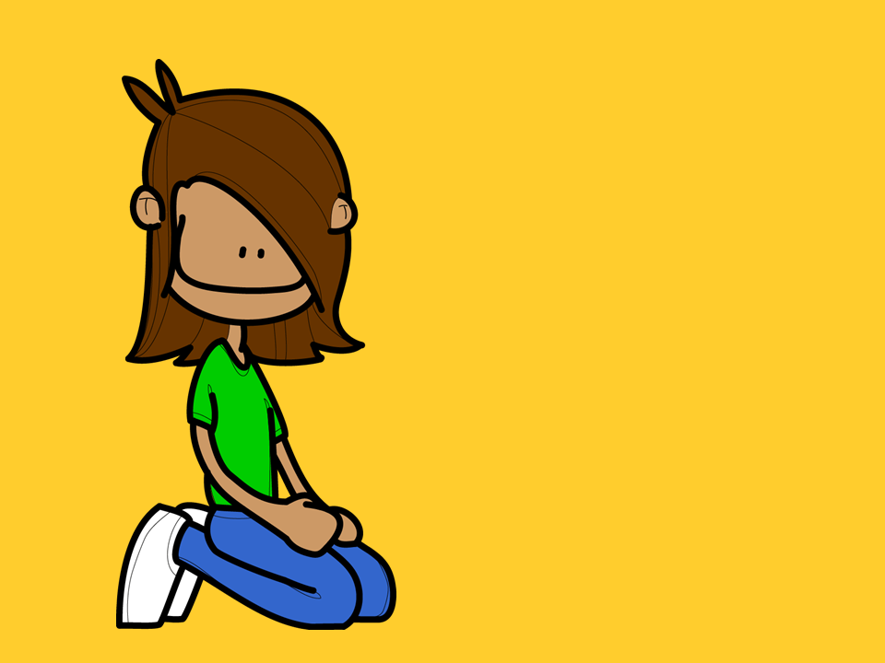
Can you find the similarities between the two things that are being compared in each of the following passages?

Slide 22
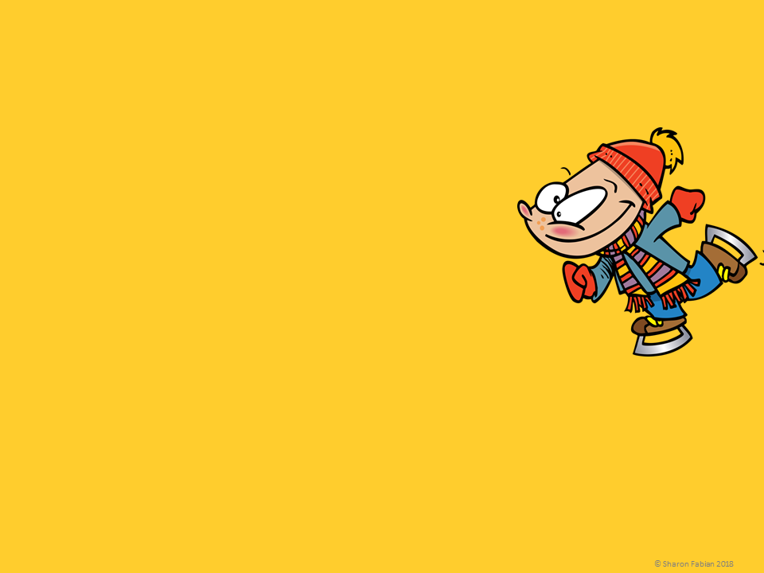
I love school holidays because I get to spend the day outdoors. Usually I go skating, which is more of a challenge, or sledding, which is easy but fun. Either way I have fun with my friends, and both activities are good exercise too!
What two things being compared?
What similarities between the two did the writer mention?

Slide 23
I love school holidays because I get to spend the day outdoors. Usually I go skating, which is more of a challenge, or sledding, which is easy but fun. Either way I have fun with my friends, and both activities are good exercise too!
Skating and sledding are being compared.
Similarities: outdoors, fun with friends, good exercise

Slide 24
My favorite genre is either science fiction or mysteries. I can’t decide. I like looking for the clues in mystery novels, but if you think about it, there are clues in sci-fi too. And both have surprises which makes the reading fun. Sci-fi has more adventure, but either one has a hero that you can root for. Guess I’ll have to pick both.
What two things being compared?
What similarities between the two did the writer mention?

Slide 25
My favorite genre is either science fiction or mysteries. I can’t decide. I like looking for the clues in mystery novels, but if you think about it there are clues in sci-fi too. And both have surprises which makes the reading fun. Sci-fi has more adventure, but either one has a hero that you can root for. Guess I’ll have to pick both.
Science fiction novels and mysteries are being compared.
Similarities: clues, surprises, heroes

Slide 26
I’m pretty sure that I want to be a teacher one day, but I can’t decide between elementary school and high school. In elementary school the kids would be little and cute, but in high school they would be interested in subjects like algebra that I would like to teach. Either way, I’d be helping kids, and similar to teaching high school, I think teaching elementary school would be an interesting job with something new happening every day.
What two things being compared?
What similarities between the two did the writer mention?

Slide 27
I’m pretty sure that I want to be a teacher one day, but I can’t decide between elementary school and high school. In elementary school the kids would be little and cute, but in high school they would be interested in subjects like algebra that I would like to teach. Either way, I’d be helping kids, and similar to teaching high school, I think teaching elementary school would be an interesting job with something new happening every day.
Teaching elementary school and teaching high school are being compared.
Similarities: helping kids, interesting jobs, something new every day

Slide 28
Can you find both the similarities and the differences between the two things that are being compared in the following passages?

Slide 29
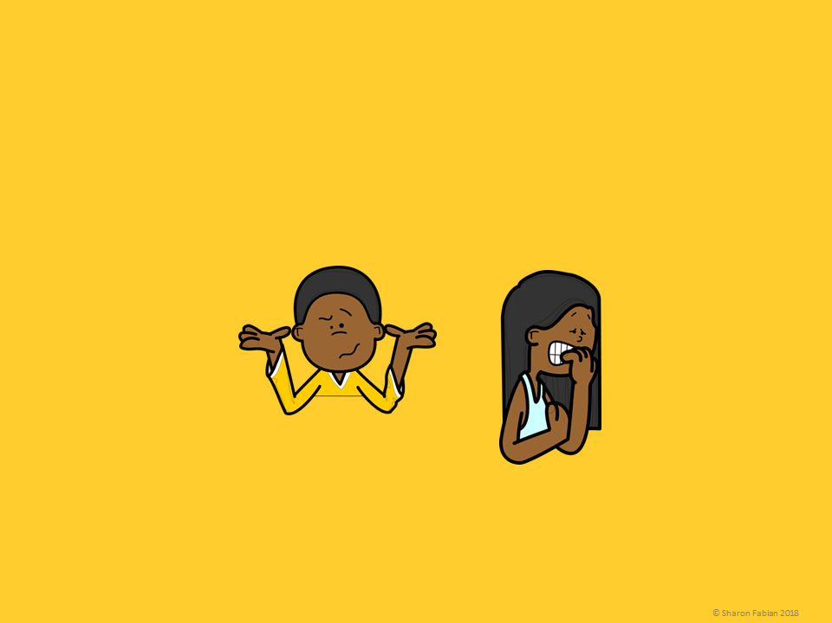
Roger and Myra were both in fifth grade, and both had just been assigned their first research project of the year. There were a lot of detailed directions, and it sounded like a BIG project. Roger said he wasn’t worried, but he did look a little confused. Myra, on the other hand, looked positively petrified.
What two things being compared?
What differences and/or similarities were mentioned?
Would you say these two things are more different or more similar? Explain your answer.

Slide 30
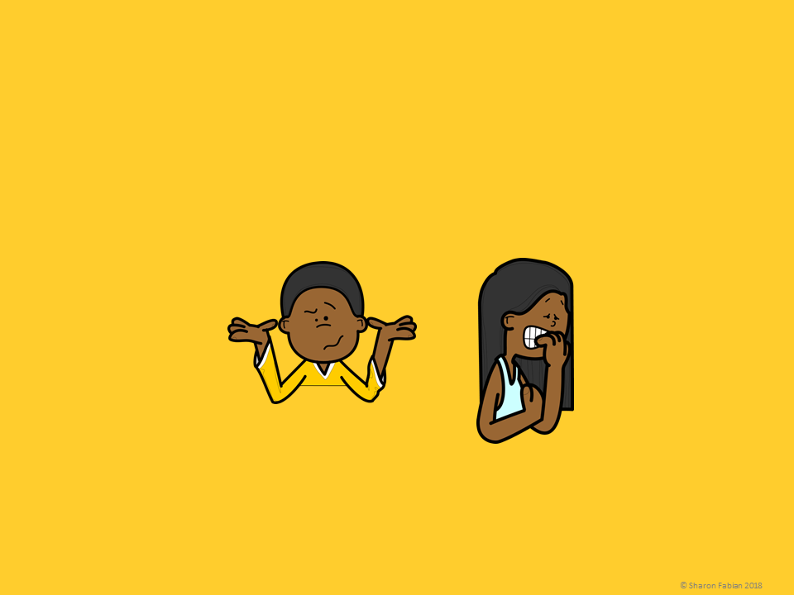
Roger and Myra were both in fifth grade, and both had just been assigned their first research project of the year. There were a lot of detailed directions, and it sounded like a BIG project. Roger said he wasn’t worried, but he did look a little confused. Myra, on the other hand, looked positively petrified.
Roger and Myra are being compared as they react to a big assignment.
Similarities: both are fifth graders, both were assigned a big research project
Differences: Roger - a little confused but not worried, Myra - scared

Slide 31
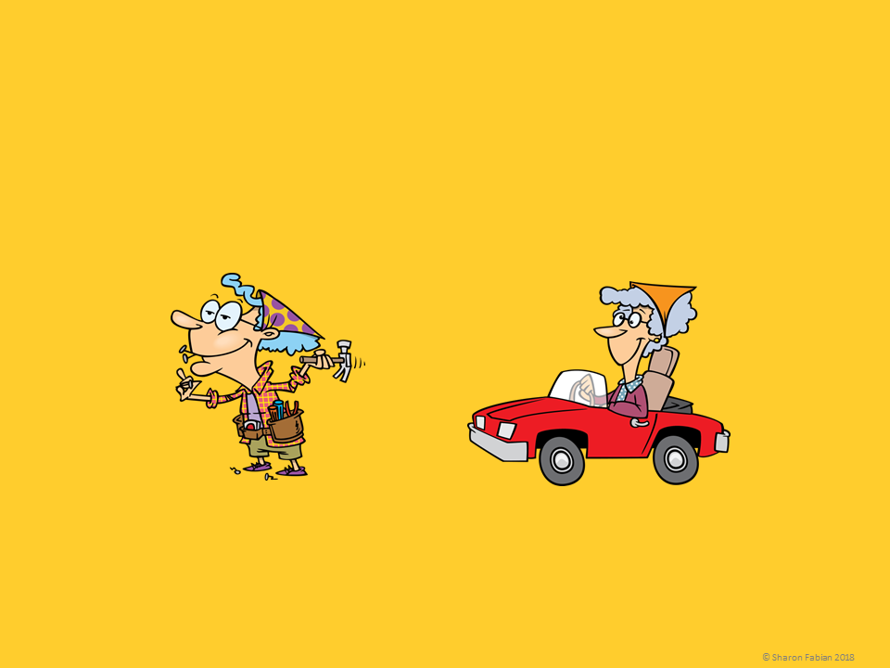
My grandmothers are two of my favorite people in the world, but they are very different! Granny Jones is a homebody, and she loves to work on projects and do small repairs around the house. Grandma Smith, on the other hand, is on the go. She loves to visit new places and is always planning a new road trip.
What two things being compared?
What differences and/or similarities were mentioned?
Would you say these two things are more different or more similar? Explain your answer.

Slide 32
My grandmothers are two of my favorite people in the world, but they are very different! Granny Jones is a homebody, and she loves to work on projects and do small repairs around the house. Grandma Smith, on the other hand, is on the go. She loves to visit new places and is always planning a new road trip.
Granny Jones and Grandma Smith are being compared.
Similarities: both grandmothers, both favorites
Differences: Granny Jones likes to do things at home, Grandma Smith likes to travel

Slide 33
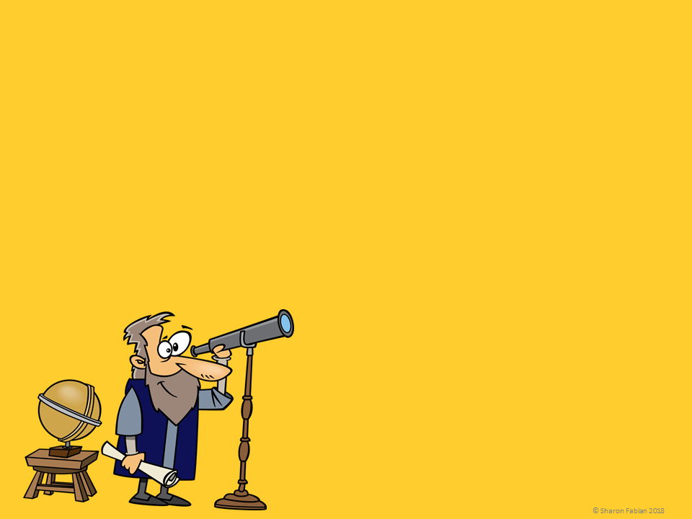
Galileo and Isaac Newton were both famous scientists and mathematicians. Galileo, an Italian astronomer born in 1564, is best known for developing telescopes and using them to make discoveries about space including several of Jupiter’s moons. Newton, an English scientist born in 1643, is best known for his work in physics, especially his theory of gravity.
Complete a Venn Diagram like the one shown here to compare and contrast the two things being compared in this passage.
Galileo
Isaac Newton
Both

Slide 34
Galileo and Isaac Newton were both famous scientists and mathematicians. Galileo, an Italian astronomer born in 1564, is best known for developing telescopes and using them to make discoveries about space including several of Jupiter’s moons. Newton, an English scientist born in 1643, is best known for his work in physics, especially his theory of gravity.
Complete a Venn Diagram like the one shown here to compare and contrast the two things being compared in this passage.
Galileo
Isaac Newton
- Born 1564
- Astronomer
- Telescopes, space, and Jupiter’s moons
Both
- Scientists
- Famous
- Made important discoveries
- Born 1643
- Physicist
- Theory of gravity

Slide 35
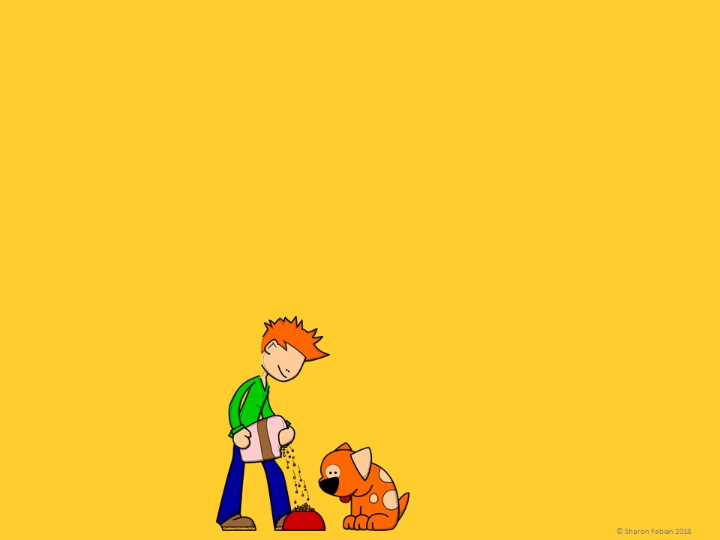
Golden retrievers always look like they are smiling. They are big dogs, weighing from 50 to 75 pounds. Golden retrievers are friendly and smart. English bulldogs, on the other hand, have a wrinkly face and a muscular build. They are medium-sized dogs that weigh from 40 to 55 pounds. What do these two dogs have in common? They are both friendly and I think they both make great pets.
Complete a Venn Diagram like the one shown here to compare and contrast the two things being compared in this passage.
Golden Retrievers
English Bulldogs
Both

Slide 36
Golden retrievers always look like they are smiling. They are big dogs, weighing from 50 to 75 pounds. Golden retrievers are friendly and smart. English bulldogs, on the other hand, have a wrinkly face and a muscular build. They are medium-sized dogs that weigh from 40 to 55 pounds. What do these two dogs have in common? They are both friendly and I think they both make great pets.
Complete a Venn Diagram like the one shown here to compare and contrast the two things being compared in this passage.
Golden Retrievers
English Bulldogs
Both
- Smiley face
Big, 50-75
lbs
- Smart
- Friendly
- Good
pets
- Wrinkly face
- Medium, 40-55 lbs
- Muscular

Slide 37
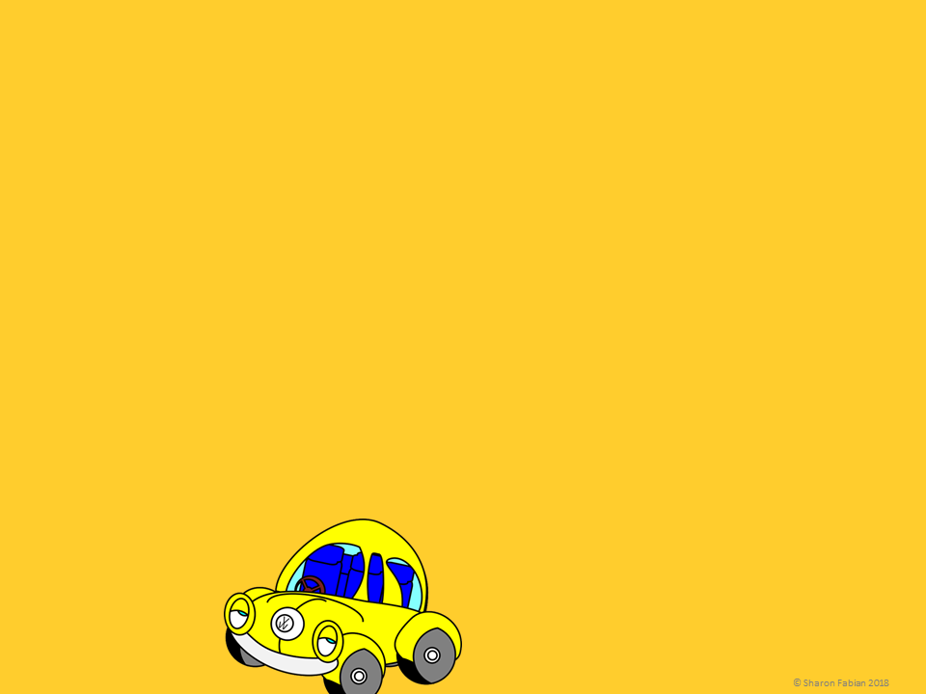
Both of my cousins drive old Volkswagens, but the similarity stops there. Even their two vehicles are actually very different. Mark’s old yellow WV bug is always polished to a high shine, and there is never a scratch on it. The old upholstery has been replaced with a neon blue fabric. Marv’s old VW van was once yellow too. Today you can still see the faded yellow top above the hand painted pink sides with their hippie flower design.
Complete a chart like the one shown here to compare and contrast the two things being compared in this passage.

Slide 38
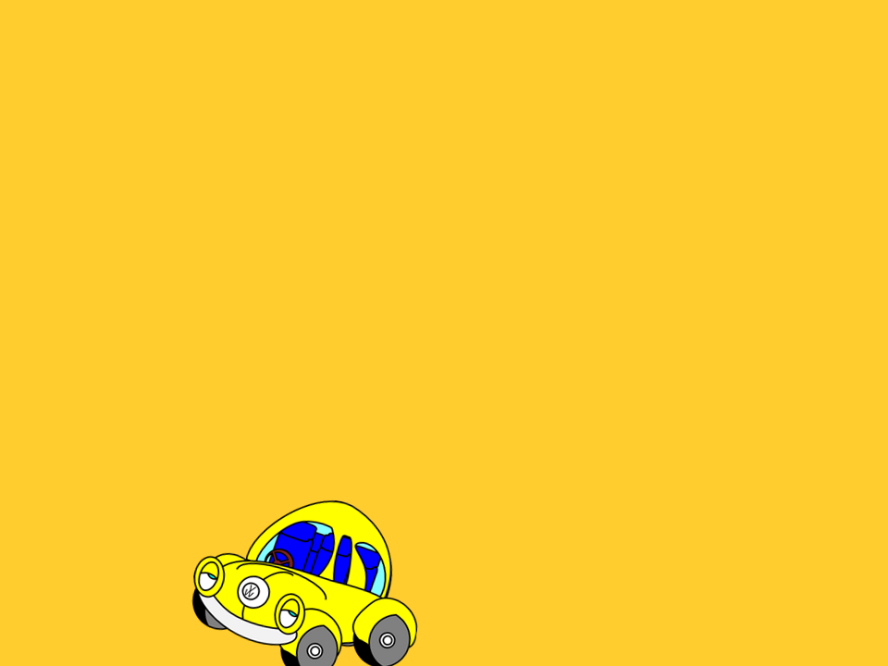
Both of my cousins drive old Volkswagens, but the similarity stops there. Even their two vehicles are actually very different. Mark’s old yellow WV bug is always polished to a high shine, and there is never a scratch on it. The old upholstery has been replaced with a neon blue fabric. Marv’s old VW van was once yellow too. Today you can still see the faded yellow top above the hand painted pink sides with their hippie flower design.
Complete a chart like the one shown here to compare and contrast the two things being compared in this passage.
Mark’s Vehicle | Marv’s Vehicle | Both
- Bug - Shiny - No scratches - New neon blue upholstery | - Van - Faded - Hand-painted pink sides with flowers | - Volkswagen - Yellow
© Sharon Fabian 2018

Slide 39
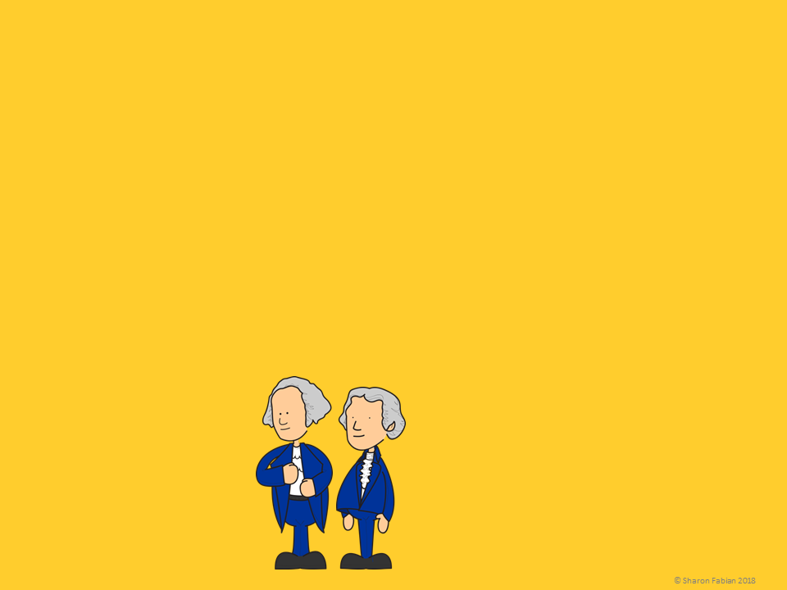
George Washington and Thomas Jefferson set the course for the United States right from the beginning. George Washington was Commander-in-Chief during the Revolutionary War and went on to be chosen unanimously as our first president by the founding fathers. Thomas Jefferson was the main author of the Declaration of Independence, and he later became John Adams’s vice president. Then, after a tie vote, Jefferson was chosen third president by the electoral college.
Complete a chart like the one shown here to compare and contrast the two things being compared in this passage.

Slide 40
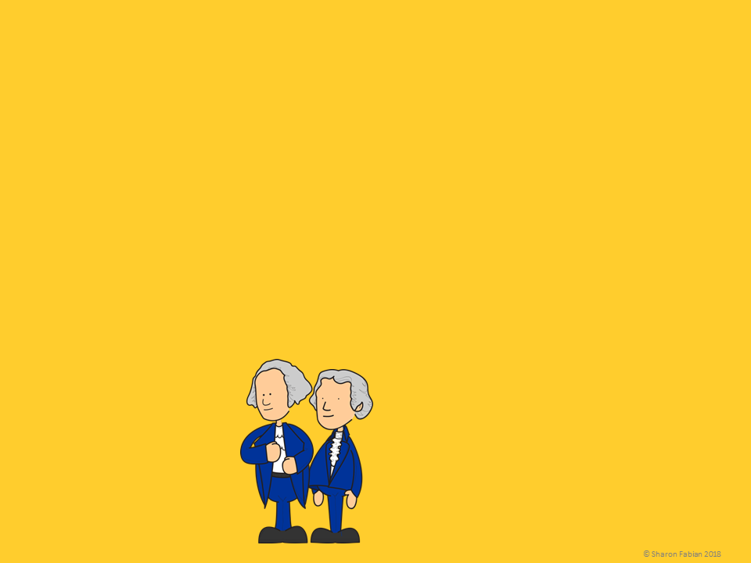
George Washington and Thomas Jefferson set the course for the United States right from the beginning. George Washington was commander in chief during the Revolutionary War and went on to be chosen unanimously as our first president by the founding fathers. Thomas Jefferson was the main author of the Declaration of Independence, and he later became John Adams’s vice president. Then, after a tie vote, Jefferson was chosen third president by the electoral college.
Washington | Jefferson | Both
- First president - Revolutionary War commander - Chosen unanimously | - Third president - Wrote Declaration of Independence - Chosen after tie vote | - President of US - Important in early US history
Complete a chart like the one shown here to compare and contrast the two things being compared in this passage.

Slide 41
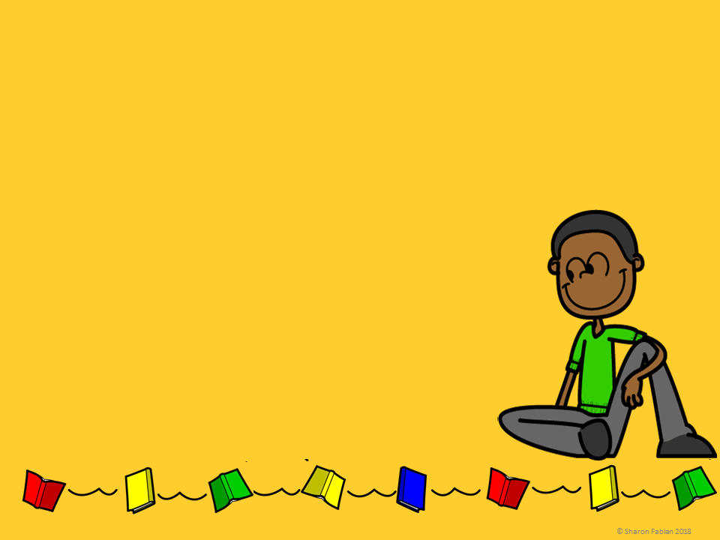
Can you name an article that you have read which had a compare and contrast text structure?
What other things would you be interested in reading about in order to compare them?

Slide 42
Name _______________________________________
Cause and Effect – Student Notebook Page
Compare and contrast is a text ____________________.
Compare and contrast means to tell the ______________________________ and the ______________________________ between two things.
These key words often signal that two things are similar. (List eight terms.)
________________________ ______________________
________________________ ______________________ ________________________ ______________________
________________________ ______________________ These key words often signal that two things are different. (List eight terms.)
________________________ ______________________ ________________________ ______________________ ________________________ ______________________ ________________________ ______________________ Sample sentence that includes both similarities and differences between two things. (Write one sentence.)
____________________________________________________________________________________________________________________________________________________________________________________________
In your sentence above, label the similarities and the differences.
Directions: Draw two graphic organizers that can be used to illustrate the compare and contrast text structure of a passage.

