Slide 1
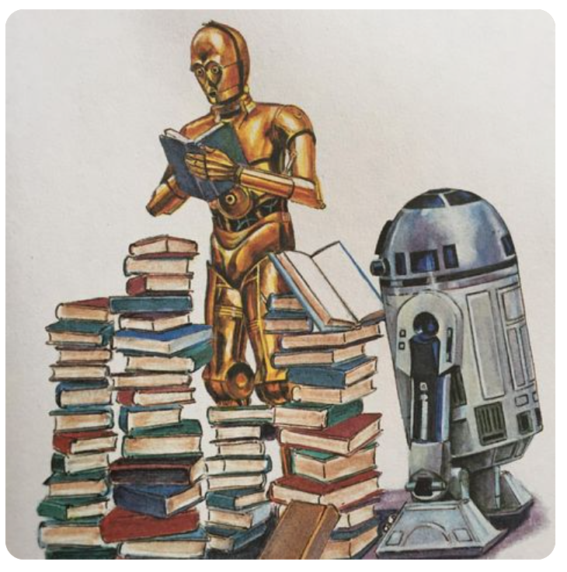
WELCOME TO 6th Grade LANGUAGE ARTS
Mrs. Goodman’s
Routines & Procedures

Slide 2
An Open Letter to Students…

Slide 3
SUCCESS…
“JOINT RESPONSIBILITY”
“You can't be afraid to fail. It's the only way you succeed - you're not gonna succeed all the time.”
LeBron James

Slide 4
SUCCESS…
If A, B, C, D…. X, Y, Z =
1, 2, 3, 4 … 24, 25, 26
Then:
KNOWLEDGE = 11+14+15+23+12+5+4+7+5= 96%
HARDWORK = 8+1+18+4+23+15+18+11 = 98%
ATTITUDE = 1+20+20+9+20+21+4+5 = 100%

Slide 5
Follow the BISON 6
SLANT
What does respect look and sound like?

Slide 6
Tardies
Be inside the room when the bell rings.
If you are late, come to class with a pass.
3 tardies will result in a disciplinary referral

Slide 7
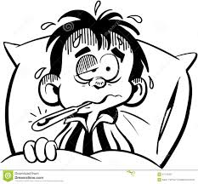
Absences
See me during advisory
Tests / quizzes will (usually) be made up during advisory
You will not be able to make up any work if you have an unexcused absence

Slide 8
Phones (etc)
Keep them locked in your locker
Visible (even the outline in your pocket)
Taken until the end of the day

Slide 9
Bookbags
Keep them locked in your locker
Bring only the materials you need.
Use the natural breaks in your day to use your locker.
Chromebook case must fit under chair

Slide 10
Chromebooks
Have with you in class EVERY DAY
Not having it will result in your handwriting your work
Charged
Use it as directed
Failure do to so will result in loss of privilege
NO extensions /or playing games

Slide 11
CLASS ROUTINES
DAILY MATERIALS
Binder with paper
Keep your binder organized… I will check it periodically
Class (reading) book
Chromebook (charged)
Pencil pouch
Assignment planner

Slide 12
CLASS ROUTINES
ARRIVAL / BELLWORK
Get your binder off the shelf.
Needed materials will be listed on the board
Take out / organize materials
“Do Now” will be on the board
Begin once you are organized
& monitor timer

Slide 13
CLASS ROUTINES
TEACHER TIME
Participate in the activities scheduled for the day
Do your best work

Slide 14
CLASS ROUTINES
INDEPENDENT WORK TIME
Reading | Writing
Choose 1 place / stay Use active reading strategies Do not interfere with ability of others to read silently Unfinished reading must be completed at home for the next day | Use the writing process… plan, draft, revise, edit Conference with peers / teachers as appropriate Conferencing guidelines will be reviewed in class

Slide 15
CLASS ROUTINES
GROUP WORK
Discussion
Research
Projects
Writing
Presentations

Slide 16
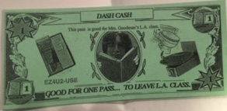
CLASS ROUTINES
BREAKS
In the room whole class break mid-way through the block period
‘Dash Cash’
- 5 per quarter
- Not during ‘teacher time’
- May earn more
- Use for credit

Slide 17
Written on the board / posted on the website
Late = points lost
Nothing is more detrimental to your overall grade than a “0”
80 155/3=
75 51%
+ 0
155
80 205/3=
75 68%
+50
205

Slide 18
DISMISSAL
Organize binder & return to shelf NEATLY.
Clean your work area and take all garbage to the trash can.
Put classroom / borrowed materials away.
Wait for MrsGoodman to dismiss you.
The ring of the bell does not dismiss you.

Slide 19
EXTRA SUPPLIES
Art Supply Cupboard
If you need to borrow / use anything.
Ask
Use the materials responsibly.
Put materials away

Slide 20
GRADING
Everything is graded.
Assignments**
Homework**
Tests & quizzes
Projects
**Low scores on key assignments will require resubmission to improve quality

Slide 21
Food & Drink
Water bottle (with lid/cap only)
Multiple allergies including nuts and gluten so ABSOLUTELY NO FOOD

Slide 22
ANY QUESTIONS…

Slide 23
Your Thoughts…
Notes:
Hand out reading questionaire.

Slide 24
Reading is…
Brainstorm for 1 minute
Share answers

Slide 25
Your thoughts…
How can this comic strip be related to reading?

Slide 26
Your Thoughts…
Reading is a transaction between the reader and the text.

Slide 27
See Ya Later…
READ
READ
READ
READ
READ

